Slide 1
Microsoft Purview Data Governance Upskilling

Slide 2
Agenda
Glossary Terms and OKRs
Health Management Controls
Data Quality
Health Management Actions
Health Management Reports
Pricing and Licensing
Custom Functionality with APIs
Introduction and Overview
Lab Setup
Designing the Data Map
Managing Data Sources
Curating Data Assets
Governance Domains
Data Products
Notes:
Introduction and Overview
Designing the Data Map
Managing Data Sources
Curating Data Assets
Governance Domains and Terms
Data Products and Access
Objectives and Key Results
Health Management Controls
Data Quality Management
Health Management Actions
Health Management Reports

Slide 3


Microsoft Purview – Introduction and Overview to Data Governance

Slide 4
74%
Can’t secure the data
Organisations struggle to secure and govern their data
68%
Can’t activate the data
47%
Can’t adhere to regulations
1. Data Security Index Report
2. 2022 Chief Data Officer survey, Deloitte, 2023.
3. ISMG First Annual Generative AI Study:
Notes:
Despite understanding the key role governance plays, many organizations still struggle to implement effective data democratization.
Customers often struggle with securing the data, activating the data, and adhering to regulatory risks.
74% of companies in a study had some data exposed in the past year
68% of companies report not being able to activate the data to apply the right insights.. Leads to poor data quality
47% of leaders are confident their organization is able to confidently meet AI regulations
Each of these are approached as a siloes today, which leads to these pain points.
Activation means making your data ready for use, analysis, or integration into applications

Slide 5
“Without proper governance and security, data & analytics initiatives are at risk of producing unreliable or compromised results”
Gartner
Notes:
Okay so, why are we interested in governance?
Well, this quote really sums up why data governance isn't just a checkbox — it's foundational. Without strong governance and security, all our data & analytics efforts are essentially built on shaky ground. We risk basing decisions on incomplete, inaccurate, or even compromised data
Emphasize the Financial Impact: Highlight that poor data quality can cost organizations significantly, with Gartner research from 2020 indicating average annual losses of $12.9 million due to issues like inefficiencies and flawed analytics
Connect to Microsoft Purview: Illustrate how Microsoft Purview can assist in establishing robust data governance frameworks, thereby enhancing data quality and security to support trustworthy analytics initiatives

Slide 6
Understanding Data Governance
Data governance ensures data is easy to find, accurate, and reliable.
Accurate data is critical for data-driven decision-making and AI effectiveness.
Poor data management can lead to mistakes, delays, and compliance risks.
High quality data is essential for organizational performance and reputation.
Notes:
We define Data Governance as the discipline that ensures data is easy to find, accurate, and reliable. And all the processes that support this are part of our governance approach.
Data governance is crucial for organizations aiming to leverage data effectively, especially in an AI-driven world. It ensures that data is accessible, reliable, and protected, which directly influences decision-making. In sectors like healthcare, finance, the consequences of poor data quality can be severe, ranging from misdiagnoses to financial losses. By prioritizing data governance, organizations can mitigate risks and enhance their operational performance.

Slide 7
Microsoft Purview
Integrated solutions to secure & govern your entire data estate
DATA SECURITY
DATA GOVERNANCE
DATA COMPLIANCE
Secure data across its lifecycle, wherever it lives
Confidently activate your data & accelerate time to insights
Manage critical risks and regulatory requirements
Data Loss Prevention
Insider Risk Management
Information Protection
Data Map Unified Catalog
Data Quality
Data Lineage
Data Health Management
Compliance Manager
eDiscovery and Audit
Communication Compliance
Data Lifecycle Management
Records Management
Unstructured & Structured data
Traditional and AI generated data
Microsoft and Multi-cloud
Shared platform capabilities
AI-based efficiency, Data Map, Classification, Labels, Audit Logs, Policies, Data Connectors
Notes:
Last year, we announced the new Microsoft Purview – your solution for comprehensive data governance, security, and compliance on ALL your data wherever it lives. The new Microsoft Purview combines our solutions for Data Security (for security leaders), Data Governance (for data officers and consumers) and Data Compliance (for risk leaders) into one unified experience and a unified underlying platform. These connected solutions are all anchored on a trusted common foundation to security navigate and innovate the digital transformation investments. The open platform gives you tremendous choice in terms of solutions you can choose and apply for your needs. ​ This is a huge step in our promise to help you protect your entire data estate. Let explore the new Data Governance experience further.

Slide 8
Why is data governance so hard for organizations?
Fragmentation
Labor-intensive tasks
Centralized Governance
Technical interfaces
Notes:
But why has it been so hard for organizations?
One of the most common pain points in data governance technology implementation is fragmentation. Many organizations find themselves inundated with tools aimed at governing and managing data. This fragmentation leads to complexity, making it challenging to maintain a unified view of data across the organization. Additionally, these tools have historically been tailored to IT, making this a tedious and centralized process that wasn’t intended to address the core issues of governance. As a result, organizations struggle to ensure data quality, security, and compliance.
Unified Catalog – Atlas
Data Lineage – Collibra, Atlan
Data Quality – Internal custom implemented
The second common pain point is the drudgery of labor intensive tasks associated with data governance. Many organizations find themselves constantly playing catch up, struggling to keep pace with the ever-evolving data landscape. Manual processes, such as data classification, metadata management, and compliance reporting can be time-consuming and prone to error. This can result in the organization on a treadmill of prep and set up-- never really able to put the practice into data governance.
The third challenge in data governance implementation is the tension between centrally managed governance and the demand for agility by the business units. Centralized governance models can sometimes stifle innovation and lead to the emergence of shadow business intelligence (BI) initiatives. Business units may get frustrated and resort to using unauthorized tools and processes to meet their specific needs, bypassing centralized governance protocols, and prone to making mistakes.
Finally, a key pain point in data governance technology implementation is lack of tools well tailored for the roles in the enterprise who need to perform different tasks. Traditional governance tools often catered primarily to IT. But with the datasphere growing at an unprecedented pace, having a business-friendly experiences that cater to self-service by data stewards and data consumers is critical.

Slide 9
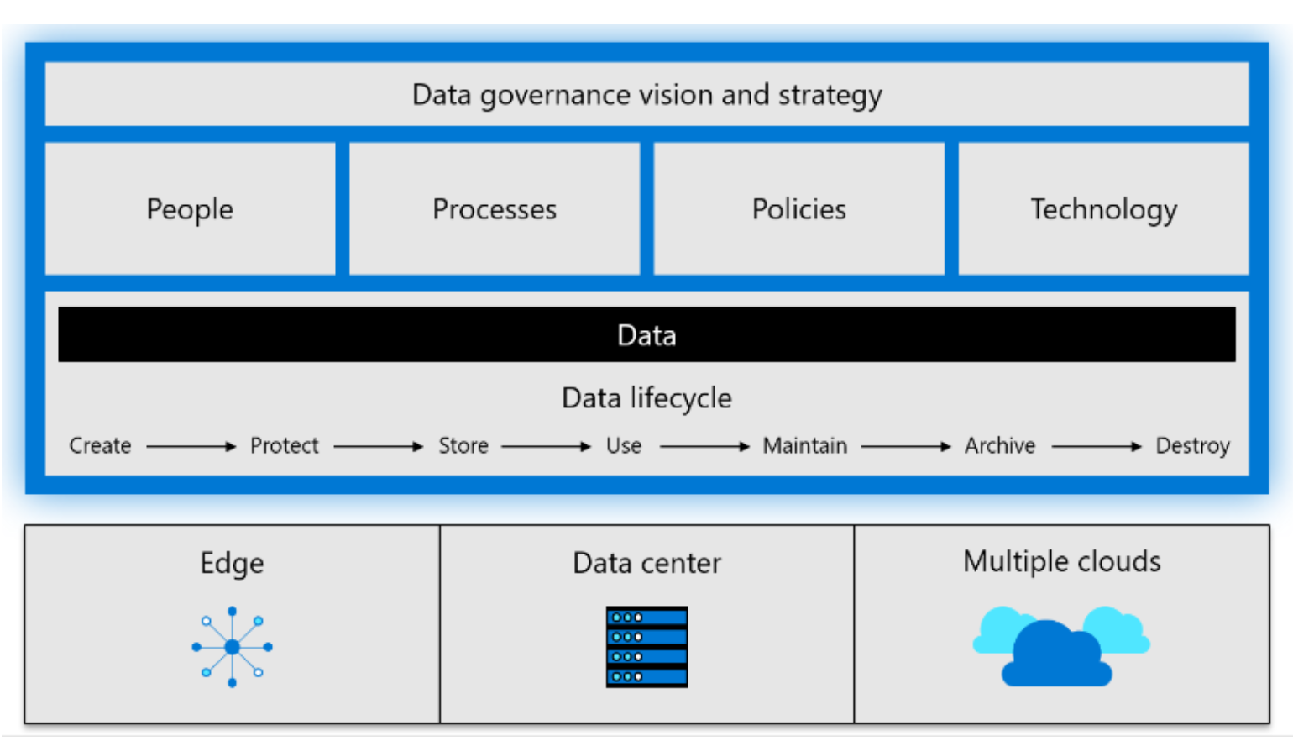
Microsoft view of data governance
The solution includes several key components:
A clear vision and strategy for data governance.
The data itself, such as customer records, supplier details, and order information.
The data lifecycle, covering everything from creation to deletion.
Defined roles and responsibilities, ensuring the right people manage data effectively.
Governance processes and activities, applied throughout the data lifecycle.
Policies and rules to regulate data handling at different stages.
Technology and tools to support and enforce data governance.

Slide 10
Organizations need a federated governance approach
Centralized
Federated
Decentralized
Responsibility at the Core
Agility at the Edge
Responsibility at the Core
Agility at the Edge
Responsibility at the Core
Agility at the Edge
Source : Forrester Research. Map a path to Federated Data Governance
10
Notes:
As we at Microsoft looked to improve our data governance, we tried multiple operating models. We have lived through three models in the last 5 to 8 years.
We began with a centralized model. This model is where you have a single team, typical a data office in an IT organization, which is accountable for managing the entire enterprise data estate. This can help you harden your controls and keep your data estate secure and compliant. The challenge with this model is when everything is gated through one team it will impact agility of the business to innovate and apply data in free and unique ways.
The next model we navigated was the decentralized model. This brings significant agility at the edge and enables business teams to innovate faster but comes with the cost of not being able to realize the efficiencies that can be gained by standardized and making more common the security compliance and privacy aspects of your data estate.
The industry is now converging towards a federated data governance model. This gives you the best of both. It enables you to maintain commonalities and consistent operations while enabling those capabilities to responsible democratize data to broader organization-wide functions and users who can self-serve in managing their data estate in discovering, understanding, accessing and applying data.
As we look to scale data governance, there are three broad operating models to consider. At Microsoft, we have lived through all three models in the last 5-8 years.
We began with a centralized model. This model is where you have a single team, typical a data office in an IT organization, which is accountable for managing the entire enterprise data estate. This can help you harden your controls and keep your data estate secure and compliant. The challenge with this model is when everything is gated through one team it will impact agility of the business to innovate and apply data in free and unique ways.
The next model we navigated was the decentralized model. This brings significant agility at the edge and enables business teams to innovate faster but comes with the cost of not being able to realize the efficiencies that can be gained by standardized and making more common the security compliance and privacy aspects of your data estate.
The industry is now converging towards a federated data governance model. This gives you the best of both. It enables you to maintain commonalities and consistent operations while enabling those capabilities to responsible democratize data to broader organization-wide functions and users who can self-serve in managing their data estate in discovering, understanding, accessing and applying data.
We at Microsoft firmly believe in the federated data governance model and in enabling these business users to rapidly accelerate business innovation with data.
Additional notes for speaker if needed:
Key Benefits:
Autonomy and Control: Local customization under a unified strategy.
Responsiveness and Agility: Quick adaptation to department-specific needs.
Scalability: Adapts to growth and changes in organizational structure.
Compliance Assurance: Maintains overarching compliance while allowing local variations.
Collaboration: Promotes knowledge sharing and best practice dissemination across units.
Why the Shift is Important:
Complex Data Landscapes: Manages increasing data intricacy efficiently.
Regulatory Compliance: Meets stringent global data protection laws.
Business Agility: Supports rapid response to market changes.
Organizational Decentralization: Suits geographically and operationally diverse entities.

Slide 11
Confidently activate your data and accelerate value creation
AI-Powered
Business Friendly
Unified & Actionable
Drive dramatic efficiency in data governance setup, management, and ongoing interaction with AI built-in across the product experience.
Accelerate adoption and success across the business with friendly terms and experience that empowers every user with experiences built for their unique role
Enable a vibrant, healthy data governance practice with real-time reports and actions that surface insights and drive federated accountability.
Notes:
That’s exactly why we launched the new Microsoft Purview Governance Experience — a unified solution purpose-built to bring that federated model to life.
It provides sophisticated yet simple business-friendly interaction, integration across data sources, AI-enabled business efficiency, and actions and insights to help you put the ‘practice’ into your data governance practice.
With this new solution you can:
Simplify and drive efficiency in data governance with AI built-in throughout the experience
Demonstrate data value with business-friendly terms and ensures that everything is anchored to your critical business outcomes.
Empower every business user by providing responsible access to high-quality data through customized experiences designed for their specific roles.
Easily govern your entire data estate—whether it resides on-premises, in the Microsoft Cloud, across multiple clouds, or within SaaS applications. Manage everything from a single pane of glass.
Enhance your data health and safety with comprehensive data estate-wide controls, intuitive dashboards, federated accountability, and recommended actions to keep your data in top shape.
With the Microsoft Purview Governance Experience, your governance practice can scale as your data and organization scale and ensure you are ready for the era of AI.

Slide 12
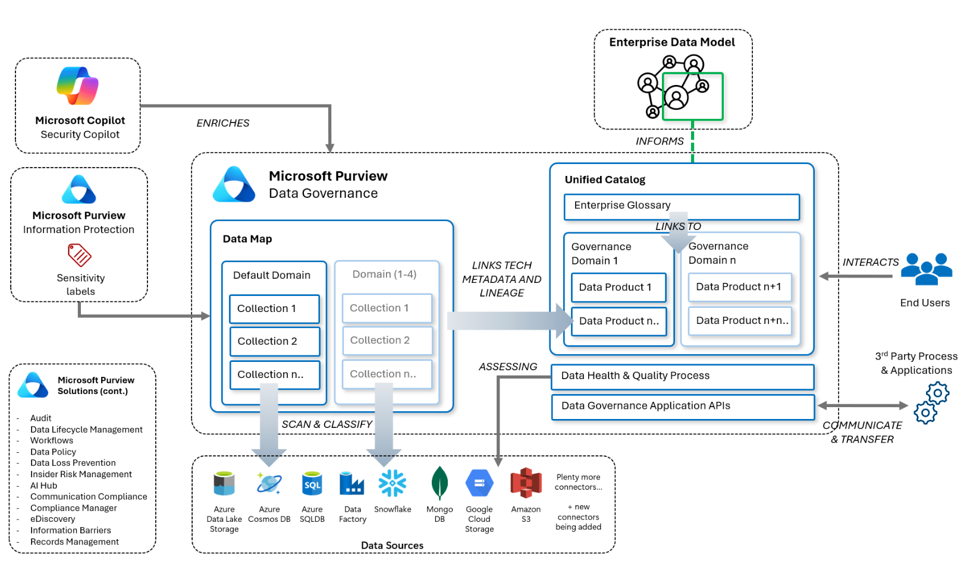
Microsoft Purview High Level Architecture
Notes:
Okay – let’s just zoom out for a second. How does this all actually work end-to-end? This diagram gives us the full picture of what Microsoft Purview is doing behind the scenes. It starts by connecting to your various data sources – whether that's Azure SQL, Data Lake, Cosmos DB, Snowflake, or even third-party sources like Google Cloud or Amazon S3. Purview scans those sources and automatically classifies what it finds – so it knows what’s sensitive, what’s structured, what formats are being used, and more.
All of that gets pulled into what's called the ‘Data Map’. You can think of the Data Map as a kind of raw index – it’s the central inventory of everything that's been discovered. It’s organised into collections and domains so you can start to manage and govern things at scale.
From there, the metadata flows into what we call the Unified Catalog. This is where the governance side really comes to life. You can start defining business terms in the glossary, organising assets into governance domains, and grouping related data into data products.
Now, there's a subtle but really important link here between the Data Map and the Catalog – and that’s where the technical metadata, like table names and data lineage, gets tied to business-friendly context, like ownership, definitions, and intended use. That’s what helps your users not just find data, but actually understand it and use it confidently.
We also have data health and quality processes built in. And this goes beyond just cleanliness. It helps you check things like completeness, accuracy, consistency, and freshness – essentially answering the question: is this data fit for purpose? It means you can proactively spot issues and improve trust before the data ever reaches a dashboard or a decision-maker.
And all of this – the scanning, the classification, the cataloguing, the quality checks – is accessible via APIs and integrates with other Microsoft tools. For example, you can bring in sensitivity labels from Microsoft Information Protection, or use Security Copilot to enrich your governance experience with automated glossary term creation and more.
So in short, Purview isn’t just a data catalog. It’s the governance engine that helps you discover, classify, manage, and protect your data across your entire organisation

Slide 13
The new Purview Data Governance Experience structure
Microsoft Purview Tenant
Catalog and Data Estate Health
Governance Domain
Governance Domain
Critical Data Elements
Glossary Terms
Critical Data Elements
Glossary Terms
Data Product
Data Product
Data Product
Datasets
Dashboards/Reports
Models
Datasets
Dashboards/Reports
Models
Datasets
Dashboards/Reports
Models
Data Map
Platform/Technical Domain
Platform/Technical Domain
Platform/Technical Domain
Collection
Collection
Collection
Collection
Technical Domains are Previously Purview “Accounts” and each tenant may have up to 5 technical domains.
Notes:
Slides need work
Top-Level Overview
"This entire diagram represents a single Microsoft Purview Tenant—essentially, your centralized hub for governance. Everything inside it—governance domains, data products, even the technical integrations in the Data Map —works together to offer a unified view of your data estate.“
I’m going to call out a few concepts, all of which we will be going into more detail later. And these concepts we may keep repeating, to help us all become more familiar.
Governance Domains, Data products and Glossary Terms
Gov domain
Governance domains are a new way of organizing your data estate. You want and need to access your entire data estate, but a single, uncategorized list is overwhelming. A business domain is a boundary that aligns your data estate to your organization; think of it as a mini catalog inside your data catalog.
2) Data Product
A data product is a group of data assets (tables, files, PBI reports, etc.), a packaged offering to an enterprise that provides assets with a use case to be shared to data consumers. A business domain can house many data products, but a data product is managed by a single business domain and can be discovered across many domains.
3) Glossary Term
Glossary terms provide a vocabulary for business users. It consists of business terms that can be related to each other and allows them to be categorized so that they can be understood in different contexts. This helps in abstracting the technical jargon associated with the data repositories and allows the business user to discover and work with data in the vocabulary that is more familiar to them.
4) Data Map
At the foundation of this structure is the Data Map, where the technical implementation resides. This is where you integrate with actual data sources
EXTRA: CDE - Critical data elements are a logical grouping of important pieces of information across your data estate. For example: A "Customer ID" critical data element can map "CustID" from one table and "CID" from another table into the same logical container. These groupings can make data easier to understand as well as promoting standardization. Data quality rules and access policies can be attached to these elements to further secure sensitive information across your data estate.
Catalog and Data Estate Health
"At the top level, we have the Catalog and Data Estate Health view. This is where Purview provides high-level insights across your data estate, enabling better decision-making.“
Governance Domains
"Within the tenant, we define Governance Domains. These can be our business-aligned areas of responsibility, such as HR, Finance, or Marketing. Each domain contains its own:
Critical Data Elements, which are the key data items necessary for business operations.
Glossary Terms, which define shared vocabulary used across the organisation.
And they're managed by Glossary Teams, ensuring the right people are maintaining these definitions.“
Data Products
"Inside each governance domain, we have Data Products. Think of these as curated, high-quality, reusable data assets. Each product includes:
Datasets, like tables or files,
Dashboards/Reports, which are our business insights,
And Models, such as powerbi semantic models.“
Data Map (Bottom Section)
"At the foundation of this structure is the Data Map, where the technical implementation resides. This is where you integrate with actual data sources."
Technical Domains
"Each tenant can have up to 5 Technical Domains, which were previously known as 'Purview Accounts'. These are typically aligned to platform teams or IT units and consist of one or more Collections, which represent groups of scanned assets."
"Technical domains power the governance domains by surfacing metadata from source systems. So, governance is layered on top of the technical structure."
Closing summary:
In essence, this model shifts governance from a tech-only focus to a business-aligned structure that reflects how your organisation actually operates—while still retaining tight integration with the underlying technical estate.
And with the addition of the Unified Data Catalog, we're now seeing a shift toward data mesh-like governance—where domains own and manage their own data products, and data is treated more like a product than just an asset.
END
In Microsoft Purview, technical and business domains interact to create a comprehensive data governance framework that aligns both technical infrastructure and business processes.
Technical domains focus on the infrastructure and systems used to manage data. They include databases, data warehouses, data lakes, and ETL tools. These domains are managed by IT professionals and data engineers to ensure the technical infrastructure is robust and secure.
Governance domains, on the other hand, align with the organisational structure and business processes. They focus on the context and usage of data within specific business areas or functions, such as finance, human resources, sales and marketing, and operations. Business domains are managed by business analysts and domain experts to ensure data is organised in a way that is meaningful to business users
The interaction between these domains is crucial for effective data governance. Here are some ways they interact:
Data Integration: Technical domains provide the infrastructure for data storage and processing, while business domains define the context and usage of this data. This ensures that data is not only stored securely but also used effectively to meet business needs.
Data Quality and Compliance: Technical domains handle the technical aspects of data quality and compliance, such as implementing data quality rules and ensuring data security. Business domains ensure that these technical measures align with business requirements and regulatory standards
Data Lineage and Metadata Management: Technical domains manage the technical metadata, such as data schemas and transformations. Business domains manage business metadata, such as data definitions and business rules. Together, they provide a complete view of data lineage and metadata, ensuring data is understood and trusted across the organisation
Collaboration and Communication: Effective communication between technical and business domains is essential for successful data governance. Regular meetings and workshops, like the ones you have been organising, help ensure that both technical and business perspectives are considered in data governance decisions
By integrating technical and business domains, Microsoft Purview helps organisations manage their data more effectively, ensuring both technical and business needs are met.

Slide 14
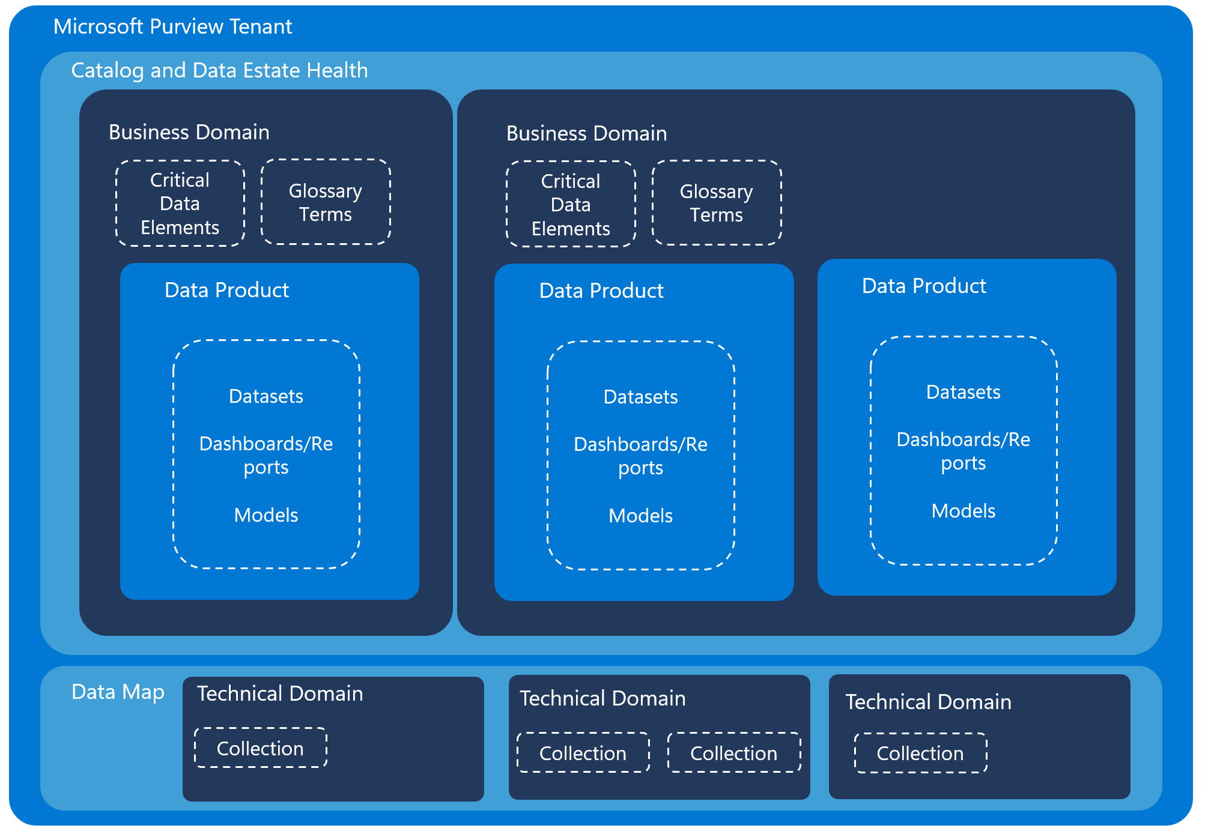
The new Purview Data Governance Experience structure
Business domains are a new way of organizing your data estate. You want and need to access your entire data estate, but a single, uncategorized list is overwhelming. A business domain is a boundary that aligns your data estate to your organization; think of it as a mini catalog inside your data catalog.
Critical data elements are a logical grouping of important pieces of information across your data estate. For example: A "Customer ID" critical data element can map "CustID" from one table and "CID" from another table into the same logical container. These groupings can make data easier to understand as well as promoting standardization. Data quality rules and access policies can be attached to these elements to further secure sensitive information across your data estate.
Glossary terms provide a vocabulary for business users. It consists of business terms that can be related to each other and allows them to be categorized so that they can be understood in different contexts. This helps in abstracting the technical jargon associated with the data repositories and allows the business user to discover and work with data in the vocabulary that is more familiar to them.
A data product is a group of data assets (tables, files, PBI reports, etc.), a packaged offering to an enterprise that provides assets with a use case to be shared to data consumers. A business domain can house many data products, but a data product is managed by a single business domain and can be discovered across many domains.

